Slide 1
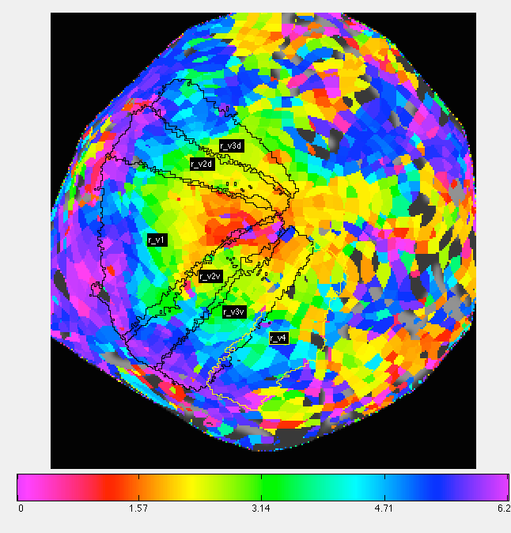
Crucial Parameters in PRF Models of Retinotopy
Daniel Birman
Psych 204b
15-03-10

Slide 2
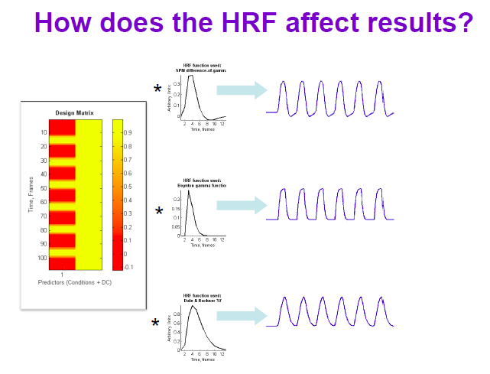

Slide 4
Polar Angle
45*

Slide 5
Polar Angle
Eccentricity

Slide 8
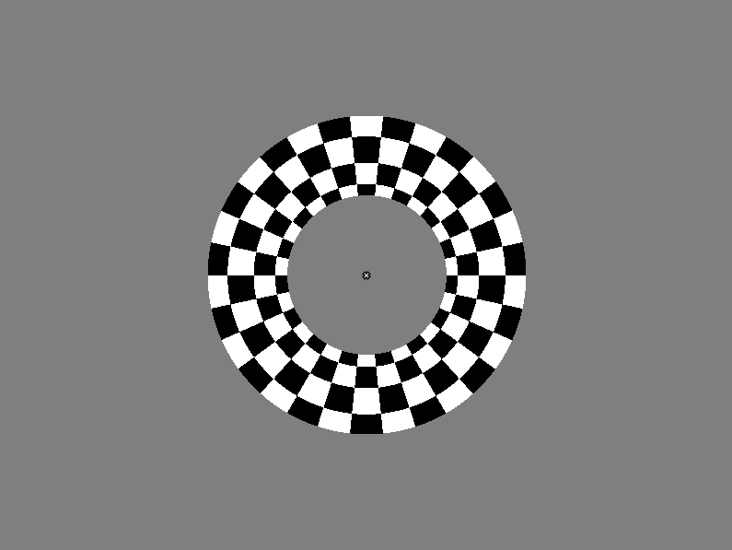

Slide 9
Standard Retinotopy
V3a
V3a
V3d
V3d
V2d
V2d
V1
V1
V2v
V2v
V3v
V3v

Slide 10
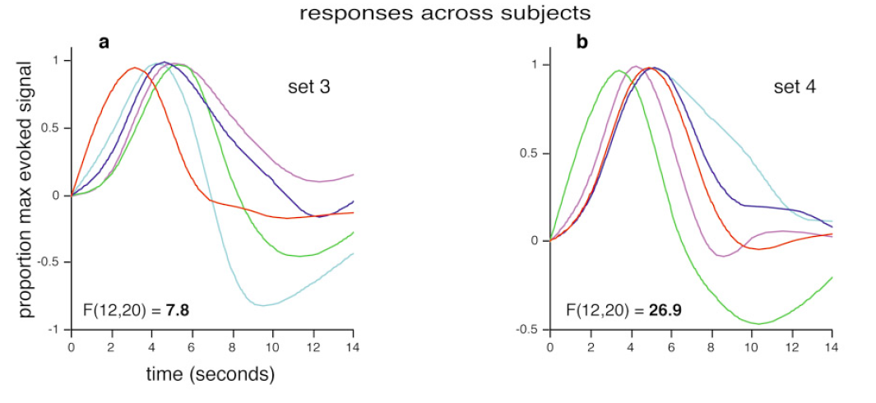
Comparing the HRF
Aguirre, G. K., Zarahn, E., & D'esposito, M. (1998). The variability of human, BOLD hemodynamic responses. Neuroimage, 8(4), 360-369.

Slide 11
Comparing the HRF

Slide 12
Comparing the HRF

Slide 13
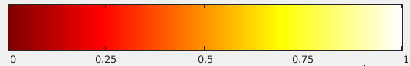

Slide 14
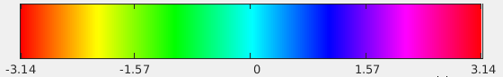

Slide 15
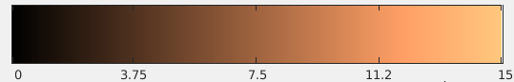

Slide 16
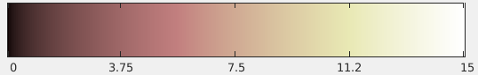

Slide 23
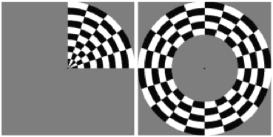
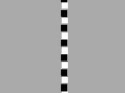
Importance of Stimulus Choice
6 Runs: 2 CW, 2CCW, 1 E, 1 C
4 Runs, each horz/vert/diag
http://www.neurobiography.info/images/teaching/retinotopy_stimuli.gif
http://gru.stanford.edu/lib/exe/fetch.php/mrtools/bars.gif?w=&h=&cache=cache

Slide 30
What Matters for the pRF?
Things that Matter:
Length of HDR

Slide 31
What Matters for the pRF?
Things that Matter:
Length of pRF
Size of “Dip”

Slide 32
What Matters for the pRF?
Things that Matter:
Length of pRF
Size of “Dip”
Things that Don’t Matter (as much):
Stimulus Choice

Slide 33
What Matters for the pRF?
Things that Matter:
Length of pRF
Size of “Dip”
Things that Don’t Matter:
Stimulus Choice
Despite these changes, the pRF estimation is quite robust—even at extremely low R^2 values it captures the qualitative aspects of retinotopy.

Slide 34
Practical Implications?
Across-subject variability can be as large as the changes here, nevertheless this suggests that fitting individual subject HDRs or even by ROI can be advantageous, but not across different sessions.
Aguirre, G. K., Zarahn, E., & D'esposito, M. (1998). The variability of human, BOLD hemodynamic responses. Neuroimage, 8(4), 360-369.

